Slide 1
Published July 2024
The Value of Post-Investment Technical Assistance in a Crisis
Learnings from
Business Support Grants scheme £1m programme for Growth Fund investees coping with COVID
July 2020 - October 2021

Slide 2
About the Growth Fund
This report examines the learnings from a rapid programme to offer grants for business support for organisations who had received investment from the Growth Fund, to help them cope with the pandemic that arrived suddenly in 2020 and had disrupted their trading models.
The Growth Fund partners, including Access, have separately produced many reports on that Fund as a whole, and further details can be found here.
However some basic facts about the Growth Fund are listed below, and these should provide sufficient background to understand the context of this report.
The Growth Fund is delivered by three partners, Better Society Capital, the National Lottery Community Fund, and Access, and launched in 2016
The overall funding pot for Growth Fund was £45m, being £22.5m repayable capital from Better Society Capital, blended with £22.5m of grant subsidy from the National Lottery Community Fund. Some other co-investors also provided finance for some of the Fund’s funds. Access did not provide finance but plays a role in the management and administration of the fund
The funding pot was made available to prospective social investors to apply for, and ultimately 16 different funds (across 14 different social investors) were created (between 2016-2020), all offering small scale (max. £150k) simple, unsecured loan products to charities and social enterprises
Three different types of Grant (called A, B and C) were offered to social investors alongside repayable capital from Better Society Capital. The grant types variously addressed issues of fund cost viability, risk and affordability of product. “Grant C” was grant to be passed through to charities and social enterprises alongside repayable investment, and as the next slide sets out, Access grants for business support during Covid were matched by a special additional release of Grant C for investors to pass on as cash grants to support vulnerable investees
In total, with some recycling of the funds available, Growth Fund made 724 investments totalling £48.6m (average size of investment £67k) by the time all funds eventually closed to deployment in December 2022
At the time of the pandemic in March 2020, the point at which the story of this Business Support Grant scheme starts, there were a total of 334 live investments (excluding those which had already fully repaid)
Background Set-up Awards Use of Grant Benefits Case Studies Lessons

Slide 3
When and Why Access delivered Business Support Grants
Mar Apr May Jun Jul Aug Sep Oct Nov Dec Jan Feb Mar Apr May Jun Jul Aug
2020 2021
Key Dates
2020
16 Mar Government discourages all non-essential contact and travel
20 Mar Joint investment Committee (JIC) of Growth Fund meets to agree 6-month easing of terms for investors
23 Mar UK goes into first lockdown
2 Apr Access Board receives and approves a proposal from the team to use £1m from its endowment to fund business support for Growth Fund investees
21 Apr JIC discusses and agrees further measures, agreeing to Access’ suggestion of an additional £1m of Grant C and up to £1m (from Access’ endowment) for Business Support grants
When the UK started to lock down during the pandemic, the Growth Fund partners rapidly convened to agree a series of measures designed to support social investors and their portfolios. The interventions mainly revolved around the nature of the funding contributed by Better Society Capital and the National Lottery Community Fund, providing patience and some additional injections of funding for both investors and investees.
Access was keen to do what it could to support such an important programme, and identified the potential to provide £1m from its endowment to match a proposed special release of £1m of the funding envelope of the National Lottery Community Fund for Grant C distributions. Whilst the Growth Fund funding itself could be distributed as direct grants into investors and investees, the proposed Access money needed to match the “capacity building” mandate of the endowment, and was therefore proposed to be used to provide enterprise support and advice in the form of Business Support Grants (BSGs). It was accepted that the urgent need of investees at that time was hard cash, but Access is not a revenue funder, and the resources that we could make available would not make a meaningful impact in any case. It was felt however that this intervention alongside the proposed Grant C injections could still be useful.
The Access Board considered and approved £1m for BSGs on 2 April 2020, just ten days after the UK went into lockdown. However the approval was conditional on £1m from Growth Fund being made available for “Grant C” interventions alongside, it being noted that:
“It is unlikely that the £1m for business support will be very effective without additional Grant C support to provide emergency revenue.” [Access Board minutes 2 April 2020]
The Joint Investment Committee (JIC) of the Growth Fund approved £1m of Grant C and also welcomed Access’ offer of £1m for BSGs on 21 April 2020. Planning began to agree distribution rules and mechanisms for both.
When the pandemic arrived, the initial assumption from partners was that it would result in 50%+ of the portfolio ultimately defaulting. These interventions were an initial response, but it was not ruled out that more might be needed in the future. They proved highly popular and supported the portfolio to hold up in the short term. And in the longer term investees proved far more resilient than at first feared, partly the result of other governmental and funding measures, and partly due to the ingenuity of the sector, as already reflected in the internal evaluation report of Access’ “Emergency Lending” programme. Therefore these proved to be the last blanket Covid interventions that Growth Fund partners would need to put in place.
Background Set-up Awards Use of Grant Benefits Case Studies Lessons

Slide 4
How Access delivered Business Support Grants
Mar Apr May Jun Jul Aug Sep Oct Nov Dec Jan Feb Mar Apr May Jun Jul Aug
2020 2021
Key Dates
Allocation of resource
Various methods were considered for spreading the £1m for BSGs between the 14 social investors in the Growth Fund. The method chosen, both for the distribution of £1m of additional Grant C and the £1m of BSGs was to split the budget according to:
Live portfolio (investees with capital still outstanding, excluding those who had fully repaid)
Number of investees rather than amount of capital outstanding
The reasons for the latter element of the method are recorded in the proposal put to the Growth Fund governing body in May 2020:
“Firstly, given the Growth Fund’s objectives, we felt it would be counter-intuitive to disadvantage those funds making smaller investments. Secondly, smaller investees may be especially vulnerable during the pandemic. And thirdly, basing allocations on value of loans outstanding would skew towards more recently disbursed investments which will not necessarily equal those VCSEs most in need.” [JIC paper, 27 May 2020]
As a result, allocations to social investors varied widely, from:
£8,454 (1% of the budget, 3 live investees) to £250,794 (27% of the budget, 89 live investees)
In total, £941,181 was allocated between 14 social investors, with grant management (see next slide) fees taking the total budget for the intervention to just over £1m. We knew that this amount would not go far enough to support all of their investees, being on average just £2.8k per organisation with outstanding capital, so we gave encouragement to social investors to target the resource at those most severely impacted by the pandemic, and those that would most benefit from this type of support.
2020
22 Apr SIB approached as delivery partner for BSGs
12 May SIB produce first draft of application and guidance
27 May JIC finalises allocations and methods for distributing £1m of Covid Grant C
29 May BSG application process and guidance finalised, and launched
22 Jul First grant award approved
14 Aug Fee structure agreed with SIB for delivery of BSGs
2021
26 Aug Last grant award approved
22 Sep First End of grant report received back
2022
7 Oct Last End of grant report received back
Background Set-up Awards Use of Grant Benefits Case Studies Lessons

Slide 5
How Access delivered Business Support Grants
Mar Apr May Jun Jul Aug Sep Oct Nov Dec Jan Feb Mar Apr May Jun Jul Aug
2020 2021
Key Dates
Distribution mechanism
Access had a live “Strategic Grant Partner” framework agreement (put in place following a tender process in 2019) with Social Investment Business (SIB) which allows for the delivery of specific grant management work without the delay of putting in place a separate tender process. SIB was therefore asked to distribute the grants. As SIB was itself a Growth Fund partner this had to be managed carefully, but having a central function where social investors could apply and have their plans checked and approved, had various advantages over providing the allocations direct to each of the social investors for them to apply directly themselves.
We agreed with SIB a light touch application process, finalised by the end of May, which aimed to keep the administrative burden to a minimum, and saw individual social investor partners remain largely in control of the process (of 116 applications, 115 were approved).
Social investors were asked to target the resource, and were able to use their existing knowledge of the organisations in their portfolio as a starting point. Most however did open up some process by which all investees could register an interest in applying. Once the organisations to benefit were selected by investors, the social investor and beneficiary investee would work together on the application, identifying the work to be done, who the supplier(s) of that work or advice would be, and how much of that investor’s grant allocation to request from SIB.
The first awards started to be approved in July 2020, and SIB concluded their work in October 2022 with the closure for receipt of end of grant reports (having had a 70% report return rate)
2020
22 Apr SIB approached as delivery partner for BSGs
12 May SIB produce first draft of application and guidance
27 May JIC finalises allocations and methods for distributing £1m of Covid Grant C
29 May BSG application process and guidance finalised, and launched
22 Jul First grant award approved
14 Aug Fee structure agreed with SIB for delivery of BSGs
2021
26 Aug Last grant award approved
22 Sep First End of grant report received back
2022
7 Oct Last End of grant report received back
Background Set-up Awards Use of Grant Benefits Case Studies Lessons

Slide 6
Size and types of Awards approved
£848,338 in BSGs was provided by 14 social investors. 115 BSGs were provided to 106 different investees. Seven VCSEs received two BSGs and one received three. 47 investees received both covid Grant C and a BSG.
The average BSG award was £7.4k and the median was £6.0k. The largest grant was £61.9k (second largest £21k) and the smallest £1.2k.
The graph below shows the categories of proposed grant spend for all grants approved, the highest amount being identified for intended business planning support, followed by financial modelling and marketing strategy support.
Overall, social investors spent almost the same amounts of their core allocations for both BSGs and the parallel covid Grant C awards.
Background Set-up Awards Use of Grant Benefits Case Studies Lessons

Slide 7
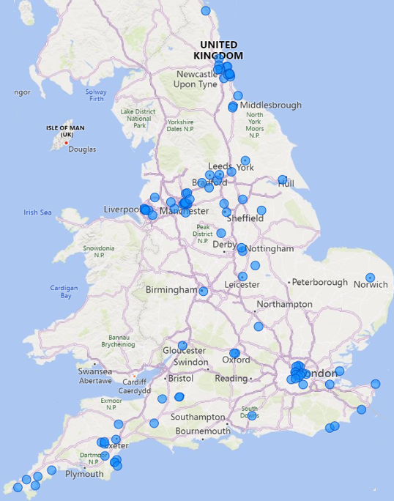
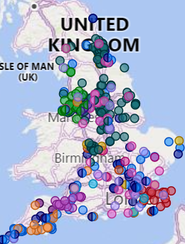
Where BSG awards went
28% of grants to IMD 1 (Growth Fund overall 22%)
53% of grants to IMD 1-3 (Growth Fund overall 48%)
Growth Fund overall
Spread of grants by IMD decile
The distribution of BSGs was fairly evenly spread across England (NB The Growth Fund was an England-only programme).
It largely mirrors the distribution of Growth Fund investments as a whole, with a broad spread but as with the whole portfolio, with particular clusters in:
London
Liverpool-Manchester
Newcastle
Devon and Cornwall
The main area where BSGs did not reflect the wider portfolio was the West Midlands where the region comprised 5% of that portfolio, but only 2% of BSGs.
The graph above shows how Business Support Grants were distributed according to the Index of Multiple Deprivation (IMD). Social investors were given no guidance as to how they should deploy BSGs, beyond applying them where the business need was most acute. It is therefore unsurprising that the spread largely matches the spread of overall investments on Growth Fund (which itself is highly skewed towards the more deprived deciles of IMD).
Other than a slightly different spread in the middle deciles (5-7) the main notable trend was an additional skewing towards the most deprived decile (1), and away from the least (9-10).
Background Set-up Awards Use of Grant Benefits Case Studies Lessons

Slide 8
Actual Use of Grant by Type
The grant management partner (SIB) had a good response to the completion of end of grant reports. We have a full data set for 81 of the 115 awards (70%) and have partial data for a further 5 awards. This page and the following two pages provide some data based on the analysis of those 81 full returns.
The graph to the right compares the original intended use of grant (blue - as outlined on the previous slide) with the eventual use of grant (green). As might be expected the two largely correlate – given that the grants were relatively small (average £7.4k) and the projects they funded relatively short term, we perhaps might not expect large discrepancies to have occurred.
Also it should be noted that whilst both sets of figures are provided as proportions of a whole and therefore comparable, the pre-grant figures are for all 115 grants, whereas the post-grant confirmed figures are for the subset of 81 returned grant reports. Therefore small discrepancies may well be explained by that sampling issue.
However sampling probably can’t explain some of the larger discrepancies, namely:
Finance related activity ended up supporting the accessing of other forms of finance (grants, contracts, refinancing of debt) far more than general financial modelling support. The pre-grant awards were the other way around.
Support for human resources activity (often mental health of staff and/or restructuring related) and digital/IT support (usually developing a better online presence) ended up higher areas of spend than anticipated. Each may not be a surprising finding given what we saw in the pandemic.
General areas of support (social impact, governance changes) and the technical area of building planning costs were areas of spend that were anticipated originally but seemed to happen to a lesser extent.
Grant Application Intend Use Actual Use of Grant
Background Set-up Awards Use of Grant Benefits Case Studies Lessons

Slide 9
Use of Grant – Number of different Uses
An interesting feature of how different Growth Fund investees used the Business Support Grant programme was in relation to the extent to which the grant was used to address multiple issues versus a single issue. Some investees clearly saw the resource as precious and developed (possibly with the support of their social investor) a careful plan to build resilience in a variety of ways. In other cases a more straightforward large project approach was adopted, with a significant amount retaining a single provider to address either a very specific issue (eg legal costs of restructure, attempted merger etc) or more general “business planning” consultancy support, usually not further defined. This analysis comes with a very significant caveat however, which is that in may cases this may simply reflect a difference in the detail of reporting provided, rather than necessarily a difference in breadth of work delivered.
The two extremes….
Single use (eg) – VCSE in Manchester - £5,000
£5,000 Organisational development and associated support
9-types outlier – VCSE in Devon - £12,452
£5,427 Marketing support over 6 months, including creation of a new lottery
£2,250 Financial modelling, sales forecasting
£1,534 Business planning (interim CEO)
£ 899 New website design and build
£ 631 HR, theory of change review (interim CEO backfill)
£ 600 Legal advice – CIC/charity conversion
£ 468 IT advice – use of Sharepoint / Teams
£ 350 Comprehensive risk assessment
£ 293 Job advertising (new CEO)
Of 81 grants to complete end of grant reports:
➔ 39 (48%) recorded just a single use of grant ➔ A further 11 (14%) recorded two uses
➔ The rest (38%) recorded three or more uses Given that the average grant size was only £7.4k, it might be considered slightly surprising that over a third of grants had as many as 3+ uses.
Where a single use of grant (39) was quoted the two most prevalent types of support were business planning (12, 31%) and support accessing other forms of finance (9, 23%)
Background Set-up Awards Use of Grant Benefits Case Studies Lessons

Slide 10
Use of Grant – Different investor approaches
Social investors varied in some ways in how they handled the allocation provided to them.
Firstly, not all allocations were awarded and disbursed. We had encouraged investors to target those charities and social enterprises in most difficulty and where this kind of advisory support could genuinely help. For some investors they received quite small allocations, and this was one of the reasons why only 90% of allocations ended up being disbursed.
Secondly investors varied quite widely in relation to how narrowly they targeted the resource. Some took the approach of spreading the opportunity amongst a significant part of their portfolios – in three cases across half or more - whereas some decided to focus the firepower on a much smaller selection. One investor reflected that almost all of their awards had gone to their investees with small management teams and small boards. This hadn’t been a conscious decision but is perhaps an insight into where that particular investor intuitively saw potential fragility
The average (and median) proportion of a portfolio that benefitted was 38%, but the range was 15% - 67%
Thirdly there were some differences between investors in the typical uses of grant reported. This could in large part simply be chance and reflective of the inherent differences in the respective portfolios. However, conversations with investors suggest that there was at least some effect from different investors themselves identifying different challenges arising from the pandemic, and encouraging investees in certain directions as a result. Also it is true that investors were also mostly providing some advice and business support themselves to their investees, so may have used BSGs to cover specialisms that they themselves could not offer. Interviews with different investors (see later) also revealed that (for example) one investor might prioritise organisations pivoting to new models, given the complexity of that work, whereas another might prioritise those with models not easily given to adaptation and pivoting, on the basis that they would be additionally vulnerable.
The table below shows the overall average amount of resource spent in some of the key areas by different investors. To avoid the skewing effects of small sample sizes, this data is only provided for the five investors (out of 14) where we received at least five grant reports back (range of number of reports received 7-30).
Proportion of portfolio to benefit - by investor
Proportion of grant spend in five key areas, by investor (top use, second use)
Background Set-up Awards Use of Grant Benefits Case Studies Lessons

Slide 11
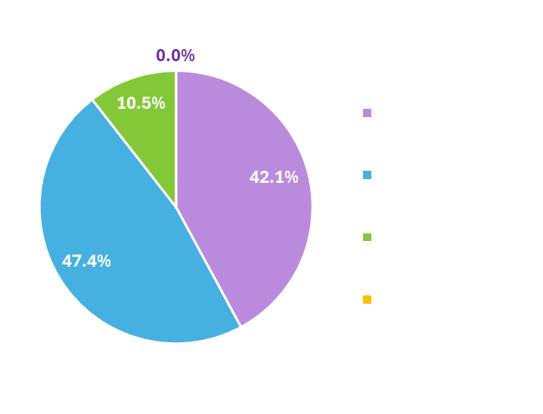
How BSGs benefitted Growth Fund – view from investees
Survey data
A final survey of all beneficiaries was carried out two years after the grants were awarded and spent, to ascertain a longer term view of the path of organisations and their reflections on the lasting value of BSGs. 26 responses were received (25% of all grant recipients, 32% of the number that filled in initial end of grant reports). This is a relatively small number, and there is also likely to be a “positivity bias” in who chose to respond, so this should be kept in mind when interpreting the (generally positive) responses received.
Quotes from end of grant reports
During Covid we stayed open through pivoting our business model. The support we received was key to this as we needed financial support and practical advice. We had to make decisions quickly which could impact on the immediate survival of the organization. Being able to think, analyse and talk these issues through became incredibly important
We have gained insight and explored new ways of engaging audiences online and also collaborating remotely. It has significantly broadened our potential impact
The grant allowed us to explore new ways of raising revenue and find new sites for solar PV. Although not wholly successful, we learnt from what we did, and are approaching our work differently. We agreed with the BSG team that we would reallocate the remaining funds
We were able to get our debt position down, secure trade income and gain recovery grant support. The financial modelling and business support we received were crucial in that we were able to access these opportunities quickly as Covid lockdown meant we needed to act with speed
By assisting the Board and Treasurer and staff team with business planning the consultant trainer greatly improved profit margins in our café/bar and improved services, new products and assistance setting up a training scheme and access to Kick Start support from DWP
We have been able to hire an expert consultant to undertake specific government calculations required for a regeneration bid. This bid was successful with their support and we were awarded £800,000
[Our consultant] created bespoke content for us and ran influencer events, pushing our traffic up and increasing sales after our digital strategy flailed in light of new privacy settings from Apple
In terms of the impact of the BSGs on the recovery of the recipient, survey respondents were surprisingly positive, with the vast majority citing significant benefits, and over 40% claiming the support played a fundamental role in their survival
The recovery path of those responding has also been encouraging. Although no causal link can be drawn to the BSGs, these results seem encouraging, particularly as those receiving support on this programme were selected due to perceived fragility. This graph shows financial situation now compared to pre-Covid:
Background Set-up Awards Use of Grant Benefits Case Studies Lessons

Slide 12
How BSGs benefitted Growth Fund – investees in numbers
Interpretation of the financial performance since Covid of the 106 organisations benefiting compared to the Growth Fund portfolio as a whole (724 investments) is difficult, as the BSG cohort was skewed by their very selection: we assume they were more prone to being fragile. So the commentary below should be treated with some caution. Nevertheless it is worth noting that:
70% of capital borrowed by BSG investees has been repaid to date (60% all other Growth Fund investees)
► Many Growth Fund investments were made after Covid, so it is not a surprise that the latter number is currently lower – both numbers will rise in time, and the latter number would be expected to rise more significantly
6% of the capital borrowed by BSG investees has already been written off (8% rest of Growth Fund)
12% of the remainder outstanding with BSG investees is considered in some danger of also being written off (10% rest of Growth Fund)
► These two figures suggest that the cohort has not fared much differently to the Growth Fund portfolio as a whole. The wider portfolio figures for these write-off categories are also expected to rise higher, as they include investments that were made in more recent years, and so have longer still to repay, and therefore longer to run into difficulty (for completeness, the balancing figures of repayments outstanding but currently on track are 12% and 22% respectively)
► There are at least two interpretations of this. It might be considered that this suggests there was not much effect of the BSGs. Alternatively, given that investors selected their most vulnerable investees, and the outturn was that they have broadly performed according to the average, if anything slightly better, this could be concluded as indicative of significant overall value arising from the BSGs
Using BSGs to secure additional resource
£909k is the total figure quoted that the support helped to unlock in new grant funding or contracts, exceeding the £848k awarded in grants overall in the programme. Others referenced accessing significant finance without quantifying, so this figure will be an underestimate
10 of the BSG portfolio of 106 investees are sadly known to have ceased trading since the support was provided. The remaining 96 are all still believed to still be trading. (no Growth Fund-wide comparator is currently available). Of these ten, one ceased training in 2021, two in 2022, three in 2023 and four in 2024)
Background Set-up Awards Use of Grant Benefits Case Studies Lessons

Slide 13
How BSGs benefitted Growth Fund – view from investors
We interviewed two of the social investors who received allocations from BSGs for their reflections on the efficacy of the programme, with the benefit of 2-3 years hindsight. These two investors together accounted for 26 grants (23% of total) totalling £338k (40% of total value). From these interviews we heard the following six insights:
1. The BSGs were beneficial to investees
It was felt that the benefits felt were variable by investee, but generally positive. In some cases extremely positive. Key features of the benefits were felt to be:
Confidence - providing reassurance at a troubling time
Timely - rapid and supportive help
Specificity – the right support against identified need, not just any support “cobbled together”
Springboard – often enabled readiness for other, larger/longer term support programmes available
“It may appear small in the grand scheme of things, but actually it was really important. It had a profound impact as it allowed organisations breathing space, and allowed them to come with developed plans for Social Enterprise Support Fund, which then saved them”
“It wasn’t necessarily about survival, but some of our organisations had to work out how to continue to deliver what they were doing in a safe and compliant way. And how to re-engage their customer base once lockdown was lifted”
2. Engagement levels varied
Some struggled to engage with the support, even having identified that they needed it. They were simply firefighting elsewhere. For post-investment support there isn’t quite the same incentivised “end-point” that there is with pre-investment support, so additional encouragement may be needed, and there may be a question of resourcing the organisation itself, to have the capacity participate with the external resource
“Organisations wanted this support, and needed it. But some then struggled to find the time to do the work they needed to do. It sometimes required a lot of chasing from our team to keep things on track, and we often found it harder to keep things on track than pre-investment support”
3. The process was light touch
An easy, simple and quick process was appreciated. Investors were already in touch with their investees and in many cases knew what was needed, and for some this was the result of having pre-existing post-investment support processes already in place. So this was a process that could fit well with the existing engagement that investors had, rather than cutting across it
Background Set-up Awards Use of Grant Benefits Case Studies Lessons

Slide 14
How BSGs benefitted Growth Fund – view from investors
4. The BSGs were beneficial to investors
Investors themselves can offer business support, and were doing so, to an extent, at this point. The ability to bring in external resource enabled investors to alleviate the workload of their staff at a difficult time, and/or enabled key specialist skill gaps to be filled (eg online sales functionality)
“From our perspective it meant that we could offer vulnerable organisations some wraparound support without our Investment Managers having to try to do this themselves – we didn’t have time for that”
5. The approach has influenced other programmes
Investors saw the value in the approach taken, and built it into subsequent grant/support programmes, either within their own organisations, or collectively, such as SESF2
6. The combination of very small scale yet bespoke had benefits and disbenefits
Some investees had very specific challenges, and it was good to be able to address these. But most had generic marketing or modelling challenges, which some felt could potentially lend themselves to generalist and scaled provision, which might have been more efficient and cost-effective
“If there was another crisis it would definitely be worth doing something similar. But there were repeated themes in the support needed, and outcomes could be more clearly defined at outset – what the support can be used for – and perhaps organised more centrally. For some organisations the needs can be very bespoke, but most were generic marketing and financial modelling support”
Background Set-up Awards Use of Grant Benefits Case Studies Lessons

Slide 15
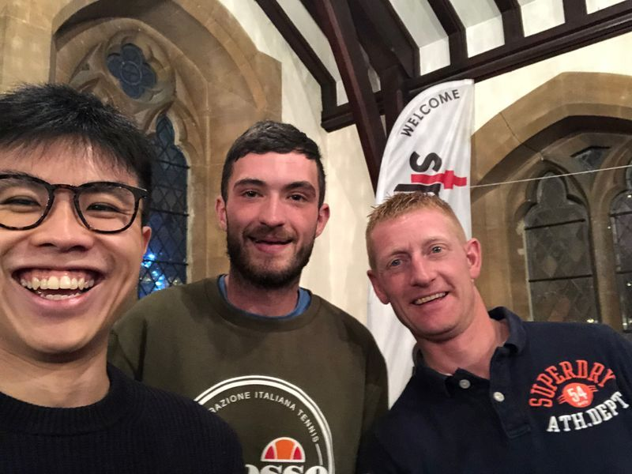
Case Study - Greater Change CIC, Oxford
Greater Change was set up in Oxford in 2018, and works through frontline charities to use personalised cash grants to help end homelessness. The have so far have helped over 1000 people. People can donate directly to a homeless individual’s final goal, which can help them overcome the financial barriers that they face.
fundraising consultant.
They hoped that this consultant could help them navigate a funding market that they didn’t feel they quite understood how to access, and therefore unlock new opportunities. While they were grateful for the support from the consultant, it didn’t quite deliver what they had hoped for. Greater Change was at the time and continues to use quite a unique model of delivery, which doesn’t fit easily into standard funders’ grant applications. In 2020 they were still struggling to articulate exactly what their main barrier to fundraising was, and therefore it was challenging for a consultant with more mainstream fundraising experience to support them.
While they felt that the experience overall was a slight net positive, this case study demonstrates that small capacity development grants, such as the £9600 received by Greater Change can be quite a blunt instrument. While bringing in an external consultant can be very useful, it’s not guaranteed, and needs to be the right individual at the right time.
Following the pandemic Greater Change went through a challenging 18 months as emergency covid funding dried up. However things turned around in mid 2023, with new funding and new opportunities over the last year allowing them to expand their work.
Case Study – The Sewing Rooms, Lancashire
new contract with a hotel chain for curtains and soft furnishings meant that they needed to expand to take on bigger premises and staff. They secured a £128k investment from LIVV Investment (£90k loan, £38k grant) in 2019 and soon after setting up for their expanded provision the pandemic struck. Almost all of their business dried up overnight. Needing an urgent pivot and a new approach, the Sewing Rooms secured some antimicrobial material and started producing PPE material anyway, focusing on face masks. These were high quality and they found a ready market, but recognising the desperate need for equipment they gave one mask away free for every one that they sold. Having established this model secured from LIVV a Covid grant from Growth Fund and a Business Support Grant from Access. They used the grant to purchase more material to scale up the face mask operation, and the business support to engage a consultant to help to establish the business model and financial projections in a new world. Ultimately 70,000 face masks were produced and distributed, supported by the new expanded premises which allowed for socially-distanced working, and backed up by a further army of volunteers working in their own homes to supplement the efforts.
The market for face masks eventually dried up as suddenly as the pandemic hat hit, but now, utilising the support of their financial consultant they were in a good position to continue to change and expand, again and again. In 2024, they have applied once more for further social investment to continue to underpin their expanded operation.
The Sewing Rooms was set up in 2010 to provide traditional skills to local women who were looking to build their confidence and employability. As well as garment and other fabric production, women can learn skills in other areas such as writing, media and event organising.
Having grown steadily in the early years, a significant
Greater Change had originally received £100k (£80k loan, £20k grant) of investment from Homeless Link in 2019 to help them to scale up their work. At the start of the pandemic they were keen to continue growing, and with the support of Homeless Link they secured a Business Support Grant from Access to bring in a fundraising consultant.
Background Set-up Awards Use of Grant Benefits Case Studies Lessons

Slide 16
What we have learnt from the BSG internal evaluation
BSGs were successful overall, and worth Access spending £1m of endowment on. It benefitted and reassured both investors and investees at a time when everything was very fragile. Evidence suggests that it supported many organisations to emerge stronger from the pandemic, and for at least some helped them to survive when they might not have done otherwise
The situation was scary and very uncertain for many. Often external support was vital, both practically and emotionally. In other cases the uncertainty meant that it was difficult to predict where external support could make a difference, and sometimes it turned out that it couldn’t really help. This was always likely to be the case, and if anything it was surprising that this seemed to be what happened in a small minority of cases
There were real differences in how BSGs were used, and in how well investors and investees engaged in the process. Not all money disbursed will have been essential or very well targeted. But that was inevitable given the designed speed of deployment
Although a one-off crisis programme, it may hold wider lessons for Access around the value of post-investment support in enabling organisations to make best use of investment and continue to be resilient and grow. Our partners often reflect the importance of such support, but how to resource it and how to organise it for greatest effectiveness are ongoing questions. Board comments: Support is crucial, esp in difficult times, but how to source it and ensure value for money tricky
Representing around 4.1% of the value of Growth Fund grant/loan investments (£1 provided by Access endowment for every £24 originally invested), BSGs were a substantial but still reasonable value for money investment, and with hindsight the allocation and methodology adopted feels largely vindicated
Background Set-up Awards Use of Grant Benefits Case Studies Lessons

